Slide 1
Physical and occupational therapy
Annual Training
2021

Slide 2
Alternative Benefit Policy Change
ABP members receive up to 20 visits of PT/OT per calendar year without prior authorization.
It is recommended that an Initial request be submitted for benefit tracking.
  This process helps to minimize duplication of services.
  It can alert you of initial requests that have already been submitted in the C3 system by your agency or other agencies.
  Allows easy submission for established request using our Copy for New Submission Process (more information on this can be requested).
The total amount of PT/OT visits allowable is 30 visits per calendar year.
All visit limits include combined PT/OT services and habilitative and rehabilitative services.
For further information regarding Member Eligibility go to https://dhhr.wv.gov/bms/Pages/Manuals.aspx Chapter 515

Slide 3
PT/OT Prior Authorization Process
WV Medicaid members can receive up to 20 visits of PT/OT per calendar year.
Prior authorization is required for members to exceed 20 visits in a calendar year.
A calendar year is the timeframe between January 1st and December 31st.
It is recommended that an Initial request be submitted for benefit tracking.
  This process helps to minimize duplication of services.
  It can alert you of initial requests that have already been submitted in the C3 system by your agency or other agencies.
  Allows easy submission for established request using our Copy for New Submission Process (more information on this can be requested).
Evaluations do not require a prior authorization unless a modality is performed on the same day.
  If able, please submit a PT/OT evaluation with the Initial authorization request.
  It is best to submit authorizations with modalities that are needed. This cuts down on confusion.

Slide 4
Authorization Numbers – Initial
  Fee-for-Service Members
  Alternative Benefit Plan
The authorization numbers for Initial requests will be suppressed.
This means that no authorization number will be generated and sent to DXC (claims payer).
The system will generate all zeros as a place holder in the C3 system. DO NOT USE THIS FOR BILLING PURPOSES.
The authorization numbers for Initial requests will be suppressed.
This means that no authorization number will be generated and sent to DXC (claims payer).
The system will generate all zeros as a place holder in the C3 system. DO NOT USE THIS FOR BILLING PURPOSES.
*It is the provider’s responsibility to check the member’s Medicaid status/type.

Slide 5
Initial vs. Established Scenarios
  20 Visits Available
  20 Visits Utilized
Jane has come to a PT/OT provider on January 1st for a complaint.
Jane has yet to use her 20 visits available through her benefit.
Even if Jane has been a patient of that provider for the last 9 months. Once the new calendar year begins the provider would start the Initial Prior Authorization Request in the C3 system.
The system will suppress the authorization number and the provider can start rendering services.
Jane has been seen by a PT/OT provider and has utilized all 20 visits after January 1st of current calendar year.
The provider would start an Established Prior Authorization Request in the C3 system.
  Even if the provider cannot see an Initial request started in C3 but knows the member has been seen for 20 visits.
  If an Initial request is already approved the system will not allow another to be created for that calendar year.
The system will generate a billable authorization number when the case is completed and approved.

Slide 6
Initial vs. Established
  Initial Request
  Established Request
An Initial request is the first prior authorization request submitted by the provider for that calendar year.
Initial requests are submitted BEFORE the 20 visits have been utilized.
An Initial request is made at the beginning of each calendar year for members seen in the previous year and is still being seen. This is true even if the member exceeded 20 visits in the previous year.
If the member has not used their 20 visits for a current calendar year, it is considered an Initial request.
Initial requests are NOT clinically reviewed AND there is no prior authorization number sent to DXC.
This is only used if the member has utilized their 20 visits for the current calendar year.
If an Established request has been initiated before the 20 units have been utilized, the member’s benefit of 20 visits without prior authorization can no longer be utilized and the provider MUST start using prior authorization numbers on claims.
Providers cannot go back to the 20 visits once an Established request has been completed.
  Once an authorization number has been generated, services from that point on will require a prior authorization.
ALL Established request submitted will be reviewed for medical necessity, regardless of number of visits used without PA.

Slide 7
Scenarios
If the member has not used their 20 visits and decided to change providers for the same area/body part – An Established request must be submitted.
If the member has not used their 20 visits and decided to change providers for a different area/body part – An Established request must be submitted.
If the member has not used their 20 visits and is staying with the same provider for a different area/body part – An Established request for the evaluation ONLY should be submitted.

Slide 8
Submission of Incorrect Member Status
If an Initial prior authorization request is submitted, even if the member has used all 20 visits of the current calendar year, the authorization number will be suppressed.
  The provider will have to do a Copy for New Submission/New Request to create an Established request. Once this is submitted, it will be reviewed for medical necessity. If approved, an authorization number will then be generated and sent to DXC. The provider will be able to view this PA as they always have.
If an Established prior authorization request is submitted before the Initial, Kepro staff will call to clarify the information submitted and to educate the provider on Initial vs. Established member status.
  Once a generated prior authorization number is sent to DXC there must be a prior authorization on all subsequent claims for any PT/OT provider.
  You cannot go back to the 20 visits once an Established request has been completed.
*Please choose carefully!

Slide 9
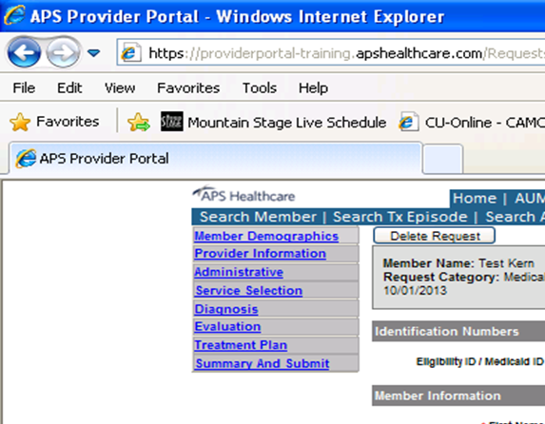
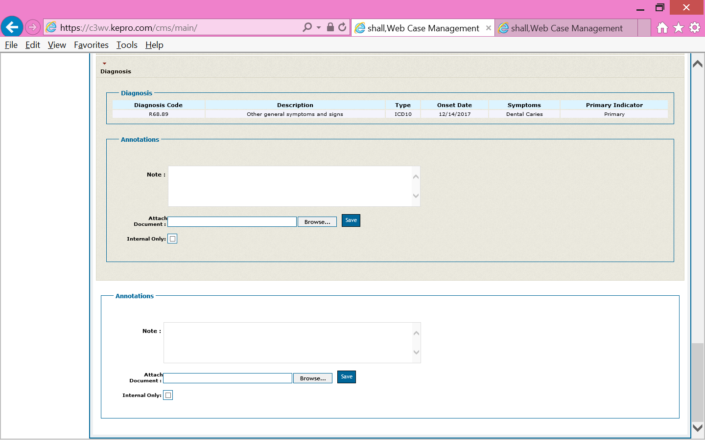
Summary and Submit Screen

Slide 10
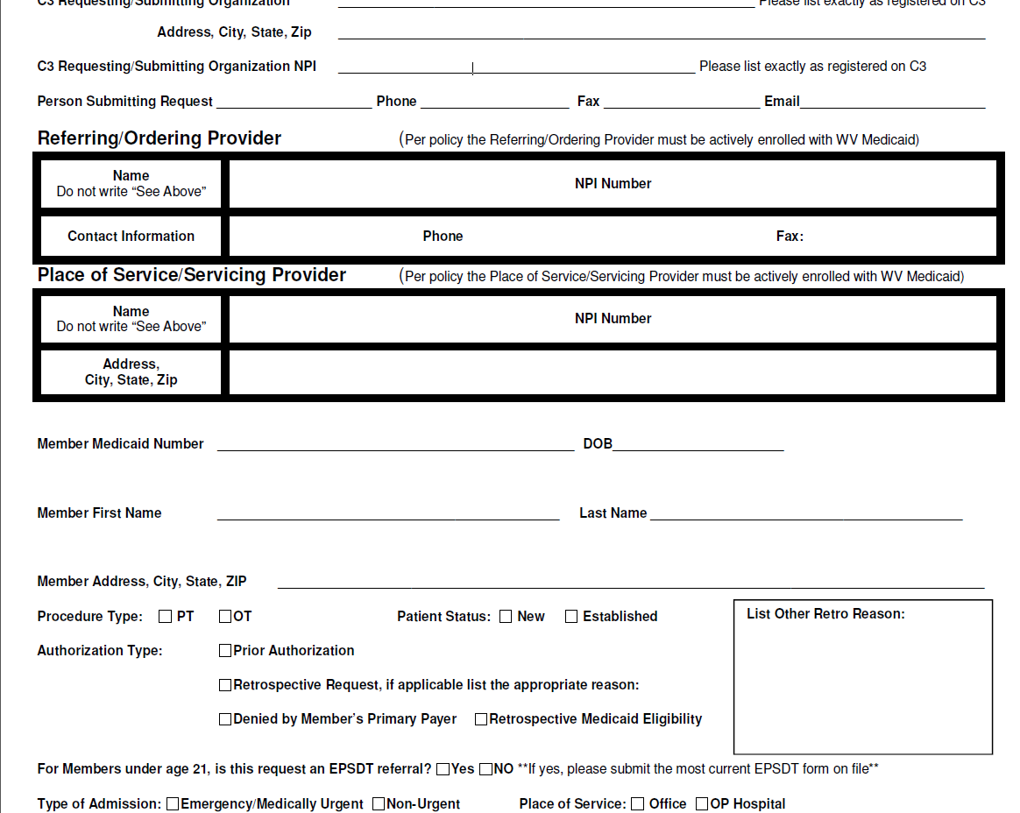
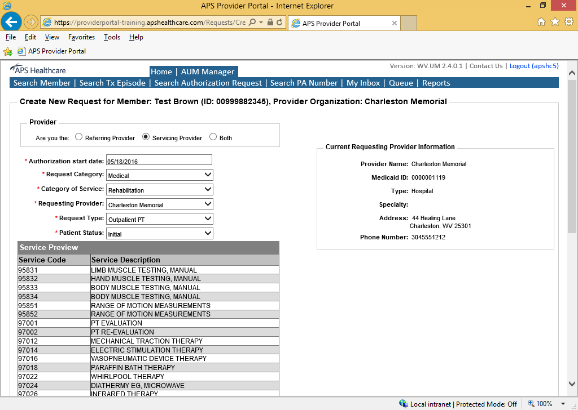
Where to Find Initial/Established When Submitting for PA

Slide 11
Modifications
Copy For New Submission: A copy for new submission is requested when a copy for correction cannot be completed due to:
  Closure of previous authorization request
  Request is stuck in saved mode and won’t submit.
Modification Form: Modification forms can be used for modifications to existing authorization for extension of end dates and units only.
  Units cannot be changed for prior authorizations with an end date of 12/31/20**.
  Units do not need adjusted on prior authorization requests that have a suppressed authorization number.
Copy for Correction: A copy for correction is requested to change or correct services previously authorized. These include but are not limited to:
  Code Changes
  Service start dates.
  Authorization number combination.
  PLEASE BE SURE TO ADD ALL SERVICE LINES ON THE COPY FOR CORRECTION!!

Slide 12
Early and Periodic Screening, Diagnosis, and Treatment (EPSDT)
HealthCheck is the name for West Virginia's EPSDT Program. The EPSDT Program is a child preventive health component of Medicaid. Federal law requires that state Medicaid programs provide medically necessary health care services to Medicaid-eligible children.
The HealthCheck Program promotes regular preventive medical care and the diagnosis and treatment of any health problem found during a screening.
There is no separate enrollment in HealthCheck. If a child is eligible for Medicaid and is under the age of 21, they automatically receive EPSDT services.
HealthCheck primary medical providers will provide children regular check-ups, screenings and preventive services based on a schedule established by medical, dental and other health care experts, including the American Academy of Pediatrics. Primary medical providers can also treat children when they are sick or refer them to an appropriate specialist if they need to see one.
More information regarding HealthCheck can be found at http://dhhr.wv.gov/HealthCheck/providerinfo/Pages/default.aspx

Slide 13
What Does This Mean for PT/OT Providers?
For non-covered items OR items or services required beyond service limits (e.g., gait trainers, standers), if the patient is under the age of 21, the PT/OT provider can work with an EPSDT provider, and these services can be requested through the EPSDT program.
  Example codes: E0637, E0638, E0642, E8000, E8001, and E8002.
These items will need to be ordered by the patient’s PCP or Pediatrician AND be part of the treatment plan developed at the screening appointment and in the provider’s record.
A HealthCheck primary medical provider must be enrolled in WV Medicaid and may be an:
  MD - Doctor of Medicine
  DO - Doctor of Osteopathic Medicine
  NP - Nurse Practitioner
  PA - Physician Assistant
Some circumstances require a registered HealthCheck provider to order the service or item.

Slide 14
EPSDT Process
The EPSDT Form is completed by the PCP or EPSDT Physician and an order written. The member selects a provider, and this provider receives the authorization to provide the service.
EPSDT cases cannot be submitted online by the provider. A fax form has to be used.
  Fax forms can be found at http://www.wvaso.kepro.com/providers/forms-enrollment/
  For COVERED ITEMS exceeding service limits the provider can indicate EPSDT on the faxed request and attach the EPSDT form and order from the referring physician.
  For NON-COVERED ITEMS the EPSDT provider must complete the request. Once completed a copy of the approval and the prior authorization number is available to the servicing provider.
The EPSDT provider must document the medical necessity for the service during the EPSDT exam or screening.
Please note, that DME vendors will not receive a 20% markup on the items being requested as EPSDT.
  This means the DME vendor will only be reimbursed for the cost of the item being requested.
  Reimbursement for unlisted/unpriced codes is based on an unaltered cost invoice including all discounts.
  PT/OT providers approved for therapy beyond service limits will be reimbursed at the Medicaid rate.
Approved authorization requests will receive a WXUTH# attached in the last annotations box on the Summary and Submit page.
  The DME provider will use this WXUTH# for billing purposes.
  EPSDT claims must be paper billed in order to receive reimbursement.

Slide 15
EPSDT Process Continued

Slide 16
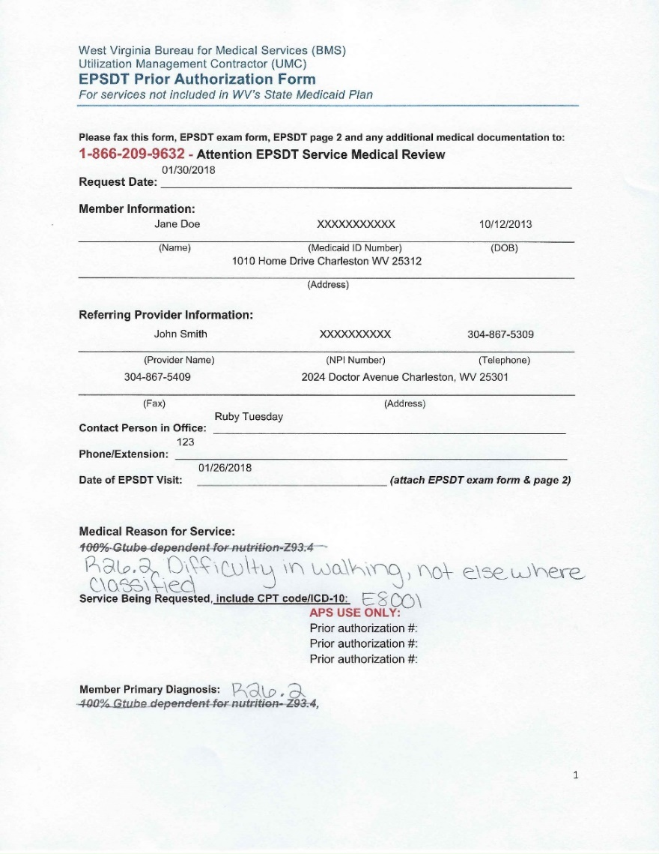
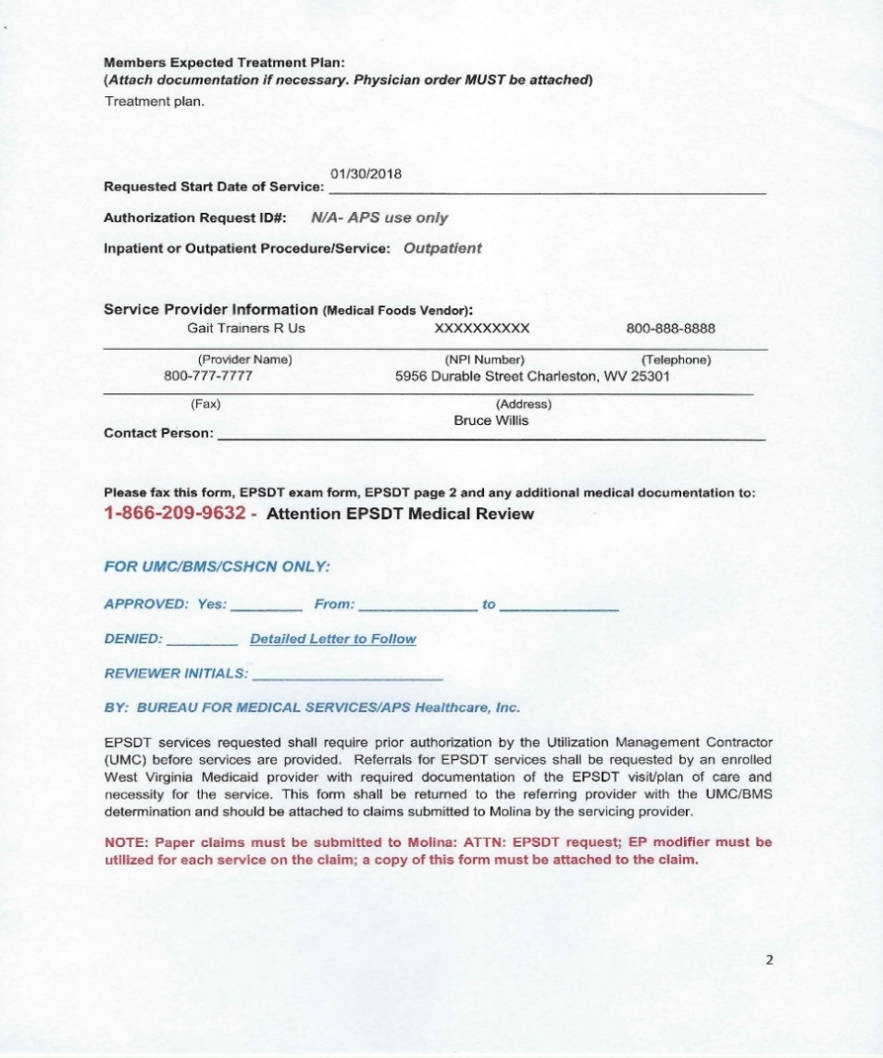
Example of EPSDT Form

Slide 17
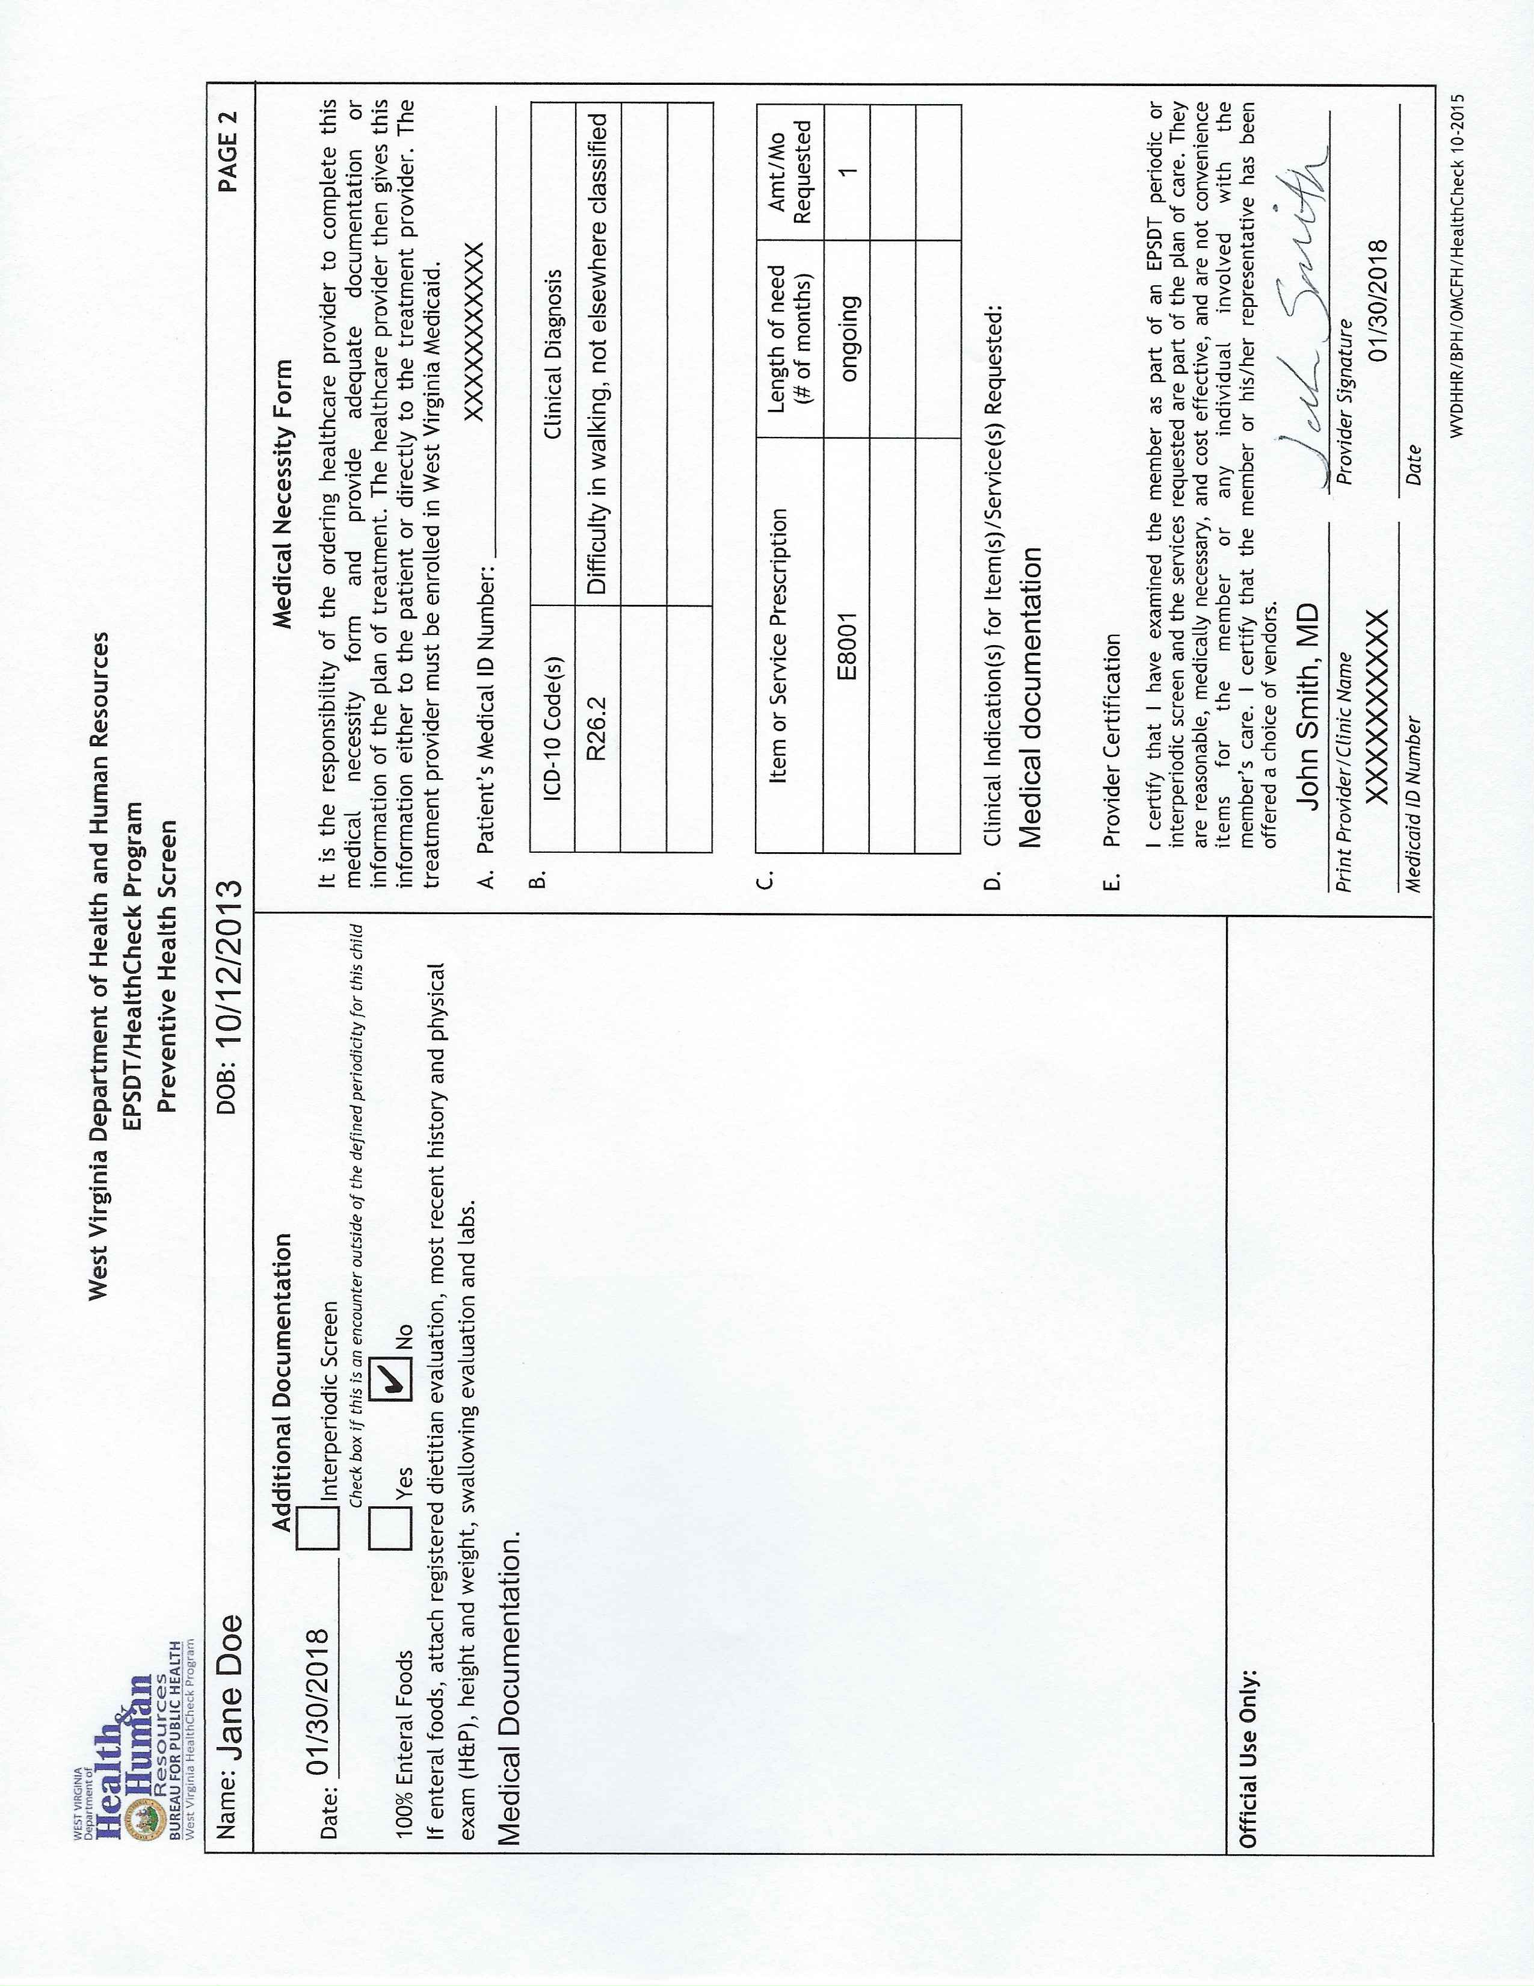
Example of EPSDT Form Page 2

Slide 18
Training and Technical Assistance
The medical department offers various types of training
We offer training via webinar, phone, and various materials.
These are offered to make submitting online for Prior Authorization an easier process for providers.
There are also annual reviews/trainings available to providers.
Provider training is also offered for various provider groups.
Each PowerPoint presentation from the provider trainings are posted to https://wvaso.kepro.com/wv-aso-medical-services.

Slide 19
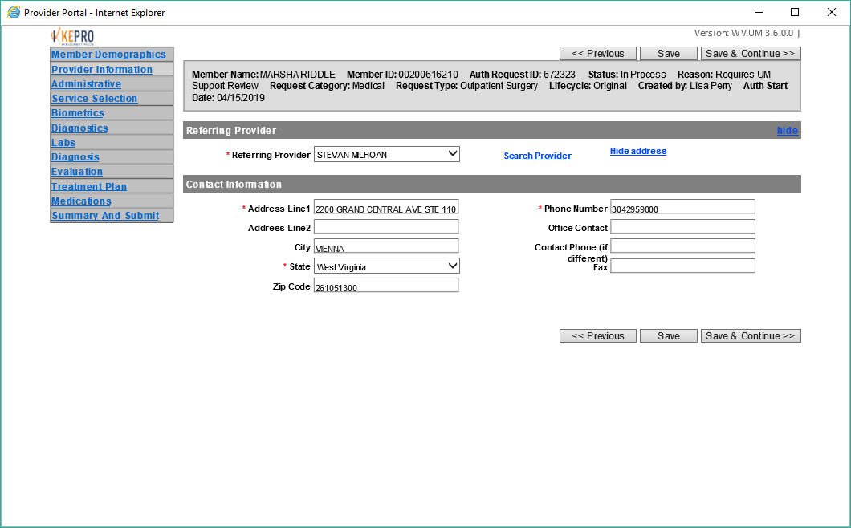
Updating Provider Contact Information
Sometimes the RN reviewers at Kepro must request additional information from providers.
Having the incorrect contact information can result in cases being closed and delaying services to the member.
Please update your contact information when submitting via DDE. This should include extensions or/and phone options.
888-867-5309

Slide 20
Kepro Medical Contact Information 1007 Bullitt Street, Suite 200 Charleston, WV 25301
1-800-346-8272 EXT. 7996 MEDICAL SERVICES EMAIL: WVMEDICALSERVICES@KEPRO.COM MEDICAL FAX NUMBER: 1-866-209-9632
EMILY PROCTOR | MEDICAL/IDDW/BH/SUD WAIVER DIRECTOR | EBPROCTOR@KEPRO.COM | EXT. 4455
KAREN WILKINSON | UM NURSE MANAGER | KAREN.WILKINSON@KEPRO.COM | EXT. 4474
ALICIA PERRY | OFFICE MANAGER | APERRY@KEPRO.COM | EXT. 4452
SIERRA HALL | TRAINING SPECIALIST | SIERRA.HALL@KEPRO.COM | EXT. 4454
JAMI PLANTIN | CUSTOMER SERVICE REP | JAMI.PLANTIN@KEPRO.COM | EXT. 4502
JASPER SMITH | CUSTOMER SERVICE REP | JASPER.SMITH@KEPRO.COM | EXT. 4490
JOHN JONES | CUSTOMER SERVICE REP | JOJONES@KEPRO.COM | EXT. 4431
LAUREN PAYNE | CUSTOMER SERVICE REP | LPAYNE@KEPRO.COM | EXT. 4408
GENERAL KEPRO AND WVCHIP INFORMATION: WWW.WVASO.KEPRO.COM FOR SUBMITTING AUTHORIZATIONS: HTTPS://PROVIDERPORTAL.KEPRO.COM WEBSITE FOR ORG MANAGERS TO REGISTER/ADD/MODIFY USERS: HTTPS://C3WV.KEPRO.COM

Slide 21

Questions?

