Slide 1
CORONAVIRUS
Presented by:
KEPRO Health Care Quality Unit

Slide 2
Disclaimer
Information or education provided by the HCQU is not intended to replace medical advice from the individual’s personal care physician, existing facility policy, or federal, state, and local regulations/codes within the agency jurisdiction. The information provided is not all inclusive of the topic presented.

Slide 3
Learn
Learn about coronavirus COVID-19 and how to be safe

Slide 4
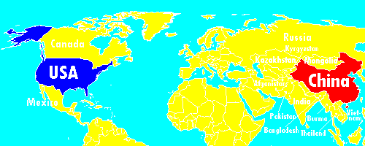

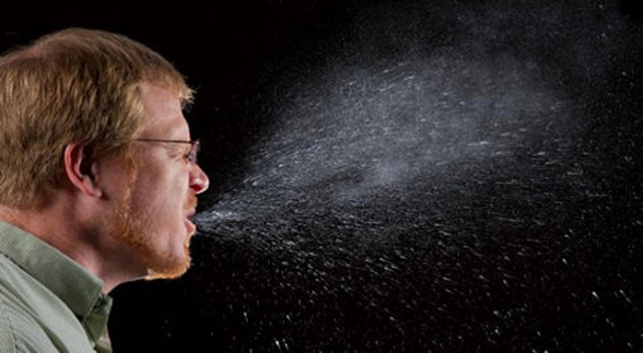
What is the Coronavirus?

Slide 5

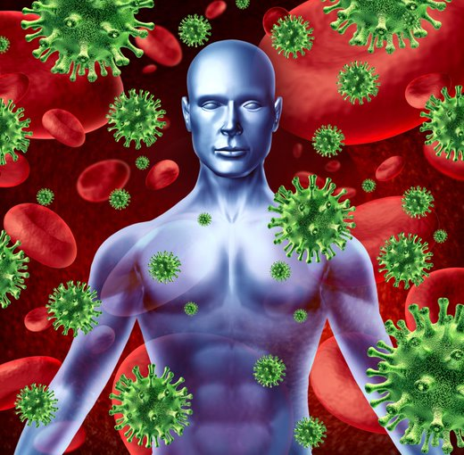

How Do You Get COVID-19?

Slide 6
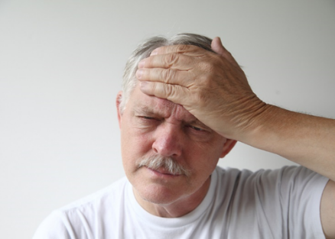
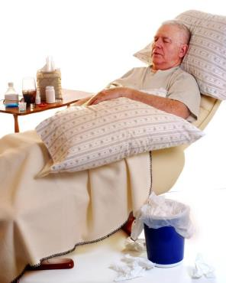
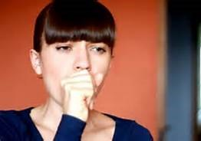

How Does COVID-19 Make You Feel?
Fever
Cough
CORONAVIRUS may cause people to have
Short of Breath

Slide 7


How Do I Know If I Have the Virus?
A test can be done to see if you have it
The doctor or nurse will put a swab in your nose to get a sample to send to a lab

Slide 8
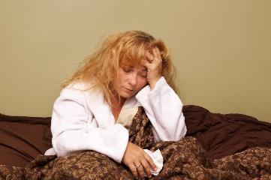

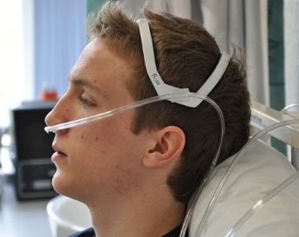
What Happens If You Have the Virus?
Some people can stay at home
Some people have to go to the hospital

Slide 9


How Can You Stop the Spread of Germs?
NO!!
YES!!

Slide 10





Washing Your Hands

Slide 11

Using Hand Sanitizer

Slide 12






Many Places Are Closed

Slide 13





Things You Can Do At Home

Slide 14

If You’re Afraid Or Have Questions
They are here for you!

Slide 15

What Did I Learn?

Slide 16



What Should You Do When You Wash Your Hands?

Slide 17
What Should You Do When You Sneeze Or Cough?

Slide 18


Who Should You Talk To If You Are Afraid Or Have Questions?

Slide 19





Things Will Get Better

Slide 20

Great Job!

Slide 21
For additional information
For additional information please visit the following websites:
https://www.cdc.gov/coronavirus/2019-ncov/about/symptoms.html
https://www.who.int/health-topics/coronavirus

Slide 22
Related Training Topics
None

Slide 23
References
Centers for Disease Control and Prevention (CDC). (March 20, 2020). Symptoms of Coronavirus. Retrieved March 24, 2020 from https://www.cdc.gov/coronavirus/2019-ncov/about/symptoms.html
Centers for Disease Control and Prevention (CDC). (March 23, 2020). Coronavirus Disease 2019 (COVID-19) Frequently Asked Questions. Retrieved March 26, 2020 from https://www.cdc.gov/coronavirus/2019-ncov/faq.html#anchor_1584386215012
FAQ: COVID-19 (coronavirus disease 2019). (February 29, 2020). Retrieved March 25, 2020 from https://medical.mit.edu/faqs/COVID-19
World Health Organization. (2020). Coronavirus. Retrieved March 24, 2020 from https://www.who.int/health-topics/coronavirus#tab=tab_1

